Slide 1
Raid Techniques

Slide 2
What is RAID ?
Redundant Array of Independent Disks
  RAID is a great system for increasing speed and availability of data.
  More data protection than non-RAID disk systems.
  Fulfils the needs of multimedia and other data hungry programs.
  Provides fault tolerance.

Slide 3
Advantages of RAID
Affordable alternative to mass storage
  Cost/Megabyte is dropping.
  Smaller drives make this possible.
  Obtain performance of expensive high end disks
High throughput and reliability
  Use of small diameter disks.
  Seek distances lower.
  High I/O rates, less power/megabyte.

Slide 4
RAID and Fault Tolerance
As more devices are added reliability deteriorates.
Files may be striped across multiple drives.
Creating redundancy in the system.
Rebuild files from redundant information.

Slide 5
Overcoming Lack of Reliability
Mirroring.
  Each disk is mirrored.
  Write operation on two disks.
  100% capacity overhead.
  Reads to disk are optimised.

Slide 6
Overcoming Lack of Reliability
Parity.
  Error correction code.
  Horizontally across disks.
Failure Prediction
  No capacity overhead.

Slide 7
Why Use RAID ?
RAID devices can act as a single drive.
Allows simultaneous read/write.
Overall increase in I/O performance.
Provides data redundancy.

Slide 8
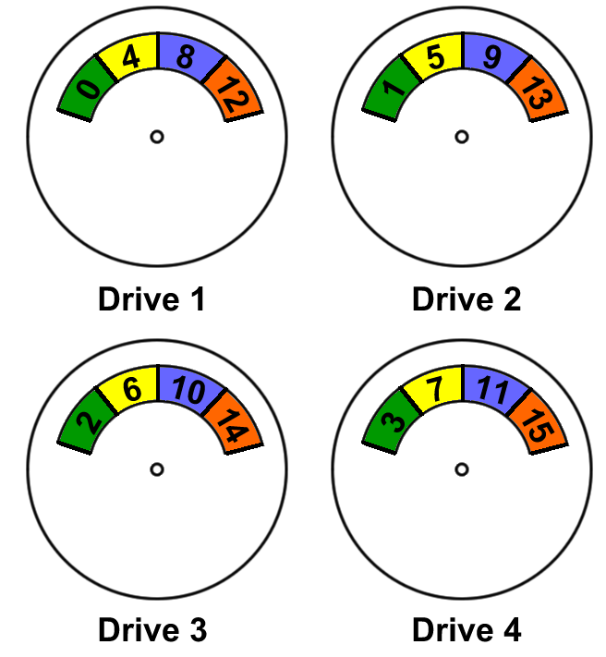
RAID Level 0
Nonredundant

Slide 9

RAID Level 1
Mirrored

Slide 10
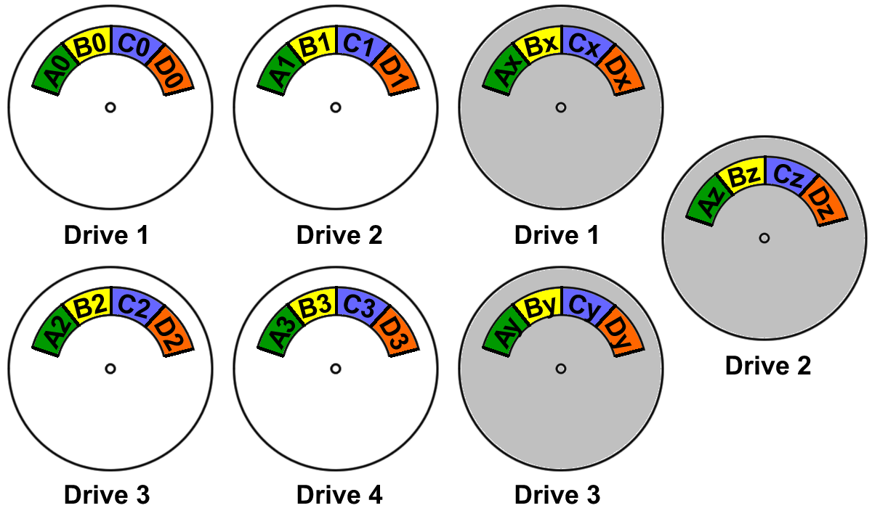
RAID Level 2
Bit-redundancy (Hemming Code ECC)

Slide 11
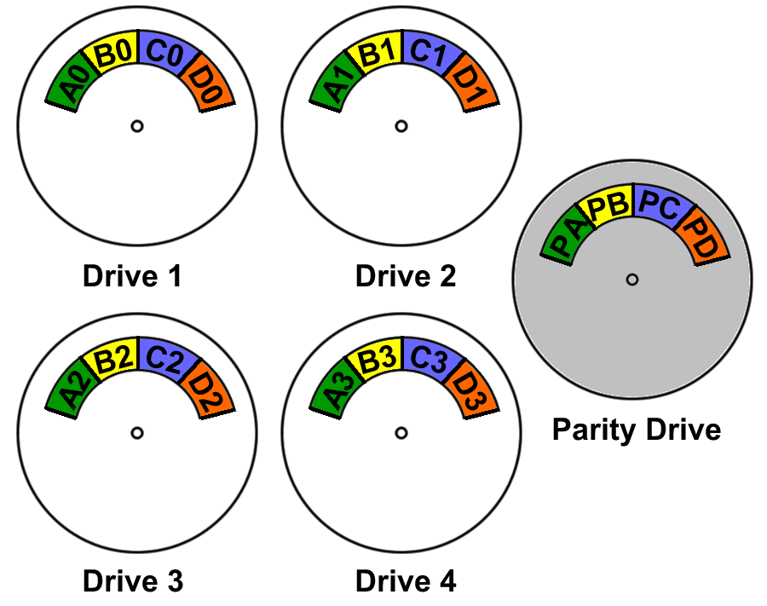
RAID Level 3
Bit-interleaved Parity

Slide 12
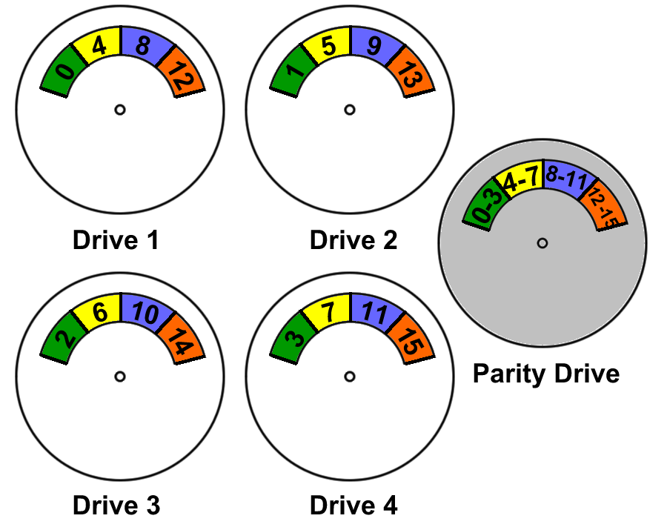
RAID Level 4
Block-level Parity

Slide 13
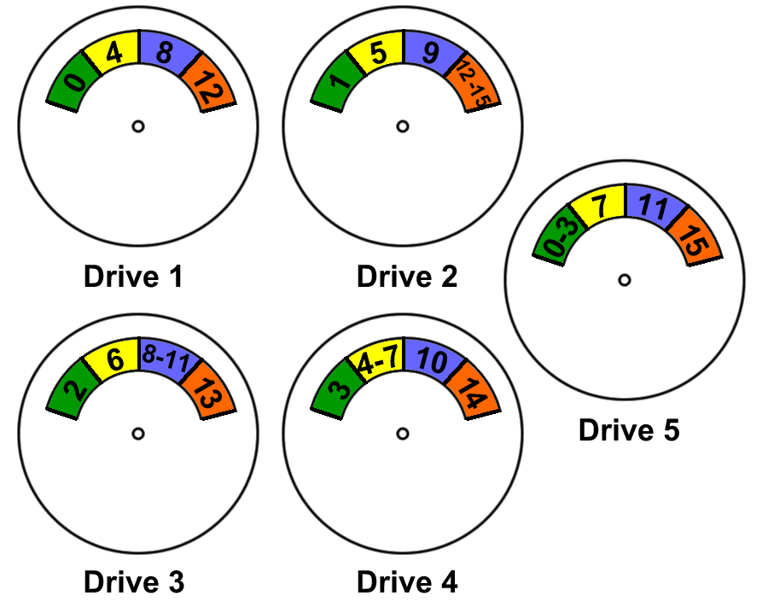
RAID Level 5
Block-level Distributed Parity

Slide 14
OVERVIEW OF RAID 6,7,10 AND 53

Slide 15
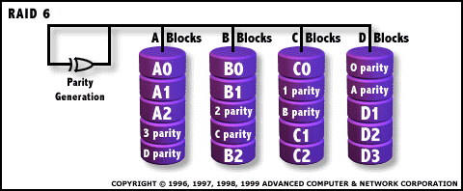
RAID 6: Independent Data disks with two independent
distributed parity schemes

Slide 16
RAID 6: Independent Data disks with two independent
distributed parity schemes
Characteristics
RAID 6 is essentially an extension of RAID level 5 which allows for additional fault tolerance by using a second independent distributed parity scheme
Data is striped on a block level across a set of drives, just like in RAID 5, and a second set of parity is calculated and written across all the drives;
Advantages
RAID 6 provides for an extremely high data fault tolerance and can sustain multiple simultaneous drive failures
Perfect solution for mission critical applications
Disadvantages
Very complex controller design
Controller overhead to compute parity addresses is extremely high
Very poor write performance
Requires N+2 drives to implement, because of second parity

Slide 17
RAID 7: Optimised Asynchrony for High I/O Rates as well as High Data Transfer Rates Characteristics/Advantages
Overall write performance is 25% to 90% better than single spindle performance and 1.5 to 6 times better than other array levels
Host interfaces are scalable for connectivity or increased host transfer bandwidth
Small reads in multi user environment have very high cache hit rate resulting innear zero access times
Write performance improves with an increase in the number of drives in the
array
Access times decrease with each increase in the number of actuators in the array
No extra data transfers required for parity manipulation
RAID 7 is a registered trademark of Storage Computer Corporation.Aa

Slide 18
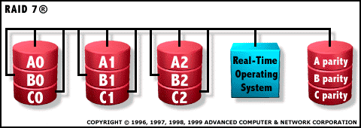
Disadvantages
One vendor proprietary solution
Extremely high cost per MB
Very short warranty
Not user serviceable
Power supply must be UPS to prevent loss of cache data

Slide 19
RAID 10: Very High Reliability combined with High
Performance
Characteristics/Advantages
RAID 10 is implemented as a striped array whose segments are RAID 1 arrays
RAID 10 has the same fault tolerance as RAID level 1
RAID 10 has the same overhead for fault-tolerance as mirroring alone
High I/O rates are achieved by striping RAID 1 segments
Under certain circumstances, RAID 10 array can sustain multiple simultaneous drive failures
Excellent solution for sites who would have otherwise gone with RAID 1 but need some additional performance boost

Slide 20
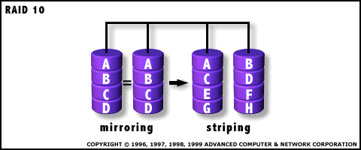
Disadvantages
Very expensive / High overhead
All drives must move in parallel to proper track lowering sustained performance
Very limited scalability at a very high inherent cost
Recommended Applications
      Database server requiring high performance and fault tolerance

Slide 21
RAID 53: High I/O Rates and Data Transfer Performance
Characteristics/Advantages
RAID 53 Should really be called "RAID 03" because it's implemented as a striped (RAID level 0) array whose segments are RAID 3 arrays
RAID 53 has the same fault tolerance as RAID 3 as well as the same fault tolerance overhead
High data transfer rates are achieved thanks to it's RAID 3 array segments
High I/O rates for small requests are achieved thanks to it's RAID 0 striping
Maybe a good solution for sites who would have otherwise gone with RAID 3 but need some additional performance boost

Slide 22
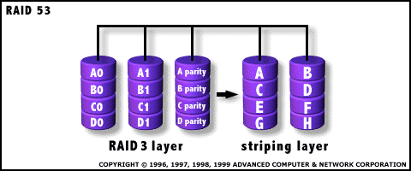
Disadvantages
Very expensive to implement
All disk spindles must be synchronised, which limits the choice of drives
Byte striping results in poor utilisation of formatted capacity

Slide 23
Software Support For RAID Under Windows NT
Windows NT Server 4.0 Supports the following RAID Levels:-
Windows NT Workstation provides no software support for RAID
RAID 1 | Disk Mirroring & Duplexing
RAID 5 | Disk Stripping With Distributed Parity

Slide 24
Software Support For RAID 1 Under Windows NT Server 4.0
Allows system and boot partitions to be mirrored.
If a member of the mirror set fails, mirror has to be broken and then a new mirror relationship needs to be created when a faulty disk is replaced.
Allows disk duplexing which often is not supported by hardware implementations of RAID.

Slide 25
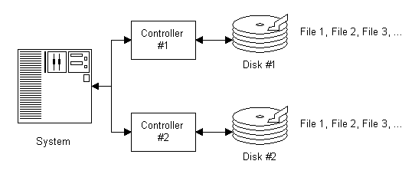
An Example of Disk Duplexing

Slide 26
Software Support For RAID 5 Under Windows NT Server 4.0
Boot or system partitions cannot be part of a stripe set with parity.
Requires a minimum of 3 disks.
Parity information is stripped across all disks. This means that in effect the storage space of 1 disk is lost due to the parity overhead.

Slide 27
Software Support For RAID 5 Under Windows NT Server 4.0
After a disk failure the fault tolerance driver uses the parity information to regenerate the data of the failed disk into RAM, having a detrimental effect on performance.
  If using RAID 5 Microsoft recommends adding 25% more memory to the system.
To recover from a disk failure, a failed disk needs to be replaced and the data needs to be regenerated on the free space on the replaced disk, using disk administrator.

Slide 28
Features of Hardware RAID Systems
Uses Dedicated Hardware to Control Disks in Array Rather Than Software.
Disks in Array Are Controlled By:-
  RAID Controller Internally Inside PC/Server.
  By Separate External System That Contains Raid Controller and Disks of Array.
Operating System Sees array as one or more fast hard disks.

Slide 29
Features of Hardware RAID Systems
No software configuration is required in operating system.
RAID Level is not limited by operating system support.
  RAID Levels available depend on hardware provider.

Slide 30
Features of Hardware RAID Systems
External RAID controllers
  Enable the use of hot swapping and hot spares of a drive in an array, in the event of failure.
  Enable the use of redundant power supplies.
  Allow re-building of array with failed drive, whilst system is on-line.
    System operates in degraded state.
    Lose fault tolerance until array is re-built.

Slide 31
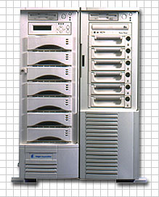
Example of an External RAID Controller Including Swappable Drives

Slide 32
Features of Hardware RAID Systems
RAID 1 Performance On Systems Using Hardware RAID.
  Read performance is better than a single drive, but not as good as many other RAID levels.
  Write performance is worse than writing to one drive, but better than many other RAID levels.
  After a disk failure read performance reduces, write performance improves.
  Rebuild is generally fast.

Slide 33
Features of Hardware RAID Systems
RAID 5 Performance On Systems Using Hardware RAID.
  Read performance varies from good to excellent for larger stripes. Parity information is not required during requests to read data.
  Write performance is poorer than other RAID levels due to the overhead of parity information.
  After a disk failure or during rebuilding, system performance can dramatically reduce due to parity information being distributed over the drives in the array.

Slide 34
Applications of RAID Level 1
Used for applications requiring fault tolerance where the funds required for the hardware for disk stripping are not available and where applications are write intensive. Applications for RAID 1 include:-
  Accounting and Financial Systems
  Small Database Systems
  Individual Users Requiring Fault Tolerance.

Slide 35
Applications of RAID Level 5
Used in systems which require good performance, good fault tolerance with efficient high capacity storage. Applications for RAID 5 include:-
  General Purpose File Servers
  Relational Database Applications.
Less suitable for write intensive applications as performance in write heavy environments decreases.

Slide 36
Raid support and implementation under Unix and Linux
Sun Operating Systems Unix/Linux
Good clustering
High-availability
Rapid disk access
Prevent disks crashes
Disk recovery

Slide 37
RAID Implementation
Software
Outboard DASD
Inboard DASD
Disk controlers

Slide 38
Software
Kernel
  Append mode
MD Multi-Device module
  Raid-0
  Raid-1
  > Raid-5
Modules:
  Raid-1
  Raid-4
  Raid-5

Slide 39
Software
Logical Volume Manager
A single disk viewed by the user
SCSI and IDE disks
Cheapest
Low-end casual environment
Hot-plug support

Slide 40
Outboard Direct Access Storage Device
Seen as a single device
SCSI-to-SCSI boxes
Hot-swap bays
The most robust, the most expensive

Slide 41
Inboard DASD
Appears as a drive
Bus-to-bus converters
SCSI-toSCSI, EIDE-to-EIDE
Only Raid-0 and Raid-1
Cheap, reliable, ease of use

Slide 42
Disk Controllers
Plugged cards
Via I/O bus
Driver loaded in the kernel
Less operations to be handle by the Operating System

Slide 43
Performance
Softwares for cheap and light work-load
Controler cards for heavy work-load

